Slide 1
Lecture 32
Deadlocks
Dr. Ehtesham Zahoor
National University of
Computer & Emerging Sciences

Slide 2


Deadlocks in the Computer World
Word
Processor
has exclusive access of
needs
Web
browser
needs
has exclusive access of
Operating Systems

Slide 3

Example of a Resource Allocation Graph

Slide 4
Methods for Handling Deadlocks
Ensure that the system will never enter a deadlock state. Deadlock Prevention and avoidance
Allow the system to enter a deadlock state and then recover. Deadlock Detection
Ignore the problem and pretend that deadlocks never occur in the system; used by most operating systems, including UNIX.

Slide 5
Deadlock Detection
Allow system to enter deadlock state
Detection algorithm
Recovery scheme

Slide 6

Resource-Allocation Graph and Wait-for Graph
Resource-Allocation Graph
Corresponding wait-for graph

Slide 7

Deadlock Detection
Is there a Deadlock?
Use any cycle detection algorithm
If there’s a cycle there’s a deadlock

Slide 8
Several Instances of a Resource Type
When multiple copies of some of the resources exist, a different approach is needed to detect deadlocks.

Slide 9
Data structures
Existence: A vector of length m indicates the total number of existing resources of each type.
Available: A vector of length m indicates the number of available resources of each type.
Allocation: An n x m matrix defines the number of resources of each type currently allocated to each process.
Request: An n x m matrix indicates the current request of each process. If Request [i_{j}] = k, then process P_{i} is requesting k more instances of resource type. R_{j}.

Slide 10
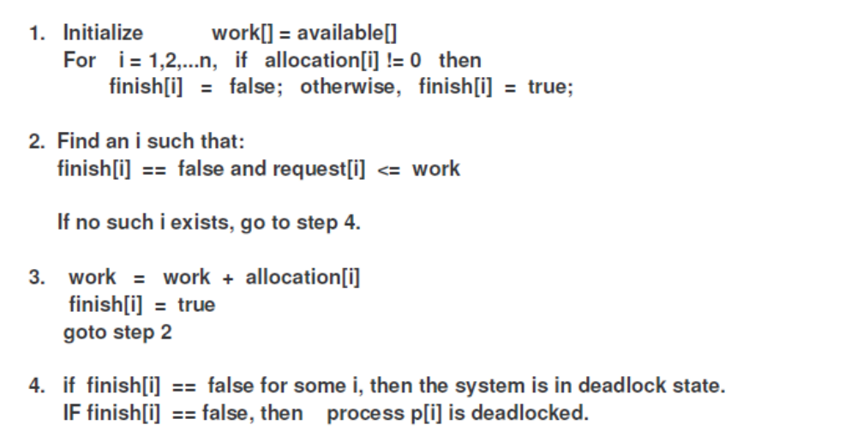
Deadlock Detection

Slide 11
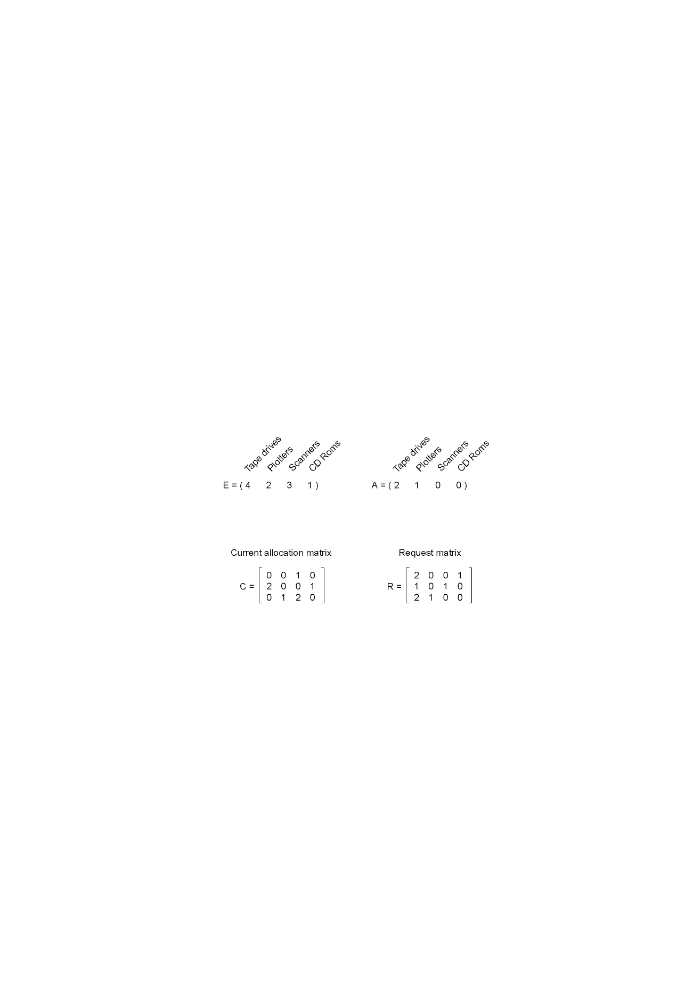
Example
Processes = 3; Resources = 4

Slide 12
Data structure
The deadlock detection algorithm is based on comparing vectors.
  A ≤ B on two vectors A and B to mean that each element of A is less than or equal to the corresponding element of B. Mathematically, A ≤ B holds iff Ai ≤Bi for1<i<m.

Slide 13
Algorithm
Each process is initially unmarked.
As the algorithm progresses, processes will be marked, indicating that they are able to complete and are not deadlocked.
When the algorithm terminates, any unmarked processes are deadlocked.

Slide 14
Algorithm
Look for an unmarked process, Pi, for which the i-th row of R is less than or equal to A.
If such a process is found, add the i-th row of C to A, mark the process, and go back to step 1.
If no such process exists, the algorithm terminates.

Slide 15
Example
Processes = 3; Resources = 4

Slide 16
Example
To run the deadlock detection algorithm, we look for a process whose resource request can be satisfied.
  The first one cannot be satisfied because there is no CD-ROM drive available.
  The second cannot be satisfied either, because there is no scanner free.

Slide 17
Example
Process 3 runs and eventually returns all its resources, giving A = (2 2 2 0)
At this point process 2 can run and return its resources, giving A = (4 2 2 1)
Now the remaining process can run. There is no deadlock in the system.

Slide 18
Example
Now consider a minor variation.
Suppose that process 2 needs a CD-ROM drive as well as the two tape drives and the plotter.
None of the requests can be satisfied, so the entire system is deadlocked.

Slide 19
Detection-Algorithm Usage
When, and how often, to invoke depends on:
  How often a deadlock is likely to occur?
  How many processes will need to be rolled back?
    one for each disjoint cycle
If detection algorithm is invoked arbitrarily, there may be many cycles in the resource graph and so we would not be able to tell which of the many deadlocked processes “caused” the deadlock.

Slide 20
Recovery from Deadlock: Process Termination
Abort all deadlocked processes.
Abort one process at a time until the deadlock cycle is eliminated.
In which order should we choose to abort?
  Priority of the process.
  How long process has computed, and how much longer to completion.
  Resources the process has used.
  Resources process needs to complete.
  How many processes will need to be terminated.
  Is process interactive or batch?

Slide 21
Recovery from Deadlock: Resource Preemption
Selecting a victim – minimize cost.
Rollback – return to some safe state, restart process for that state.
Starvation – same process may always be picked as victim, include number of rollback in cost factor.

Slide 22
Combined Approach to Deadlock Handling
Combine the three basic approaches
  prevention
  avoidance
  detection
allowing the use of the optimal approach for each of resources in the system.
Partition resources into hierarchically ordered classes.
Use most appropriate technique for handling deadlocks within each class.

Slide 23

Traffic Deadlock

